Slide 1
Chapter 3.5 Art of Africa and the Pacific Islands

Slide 2
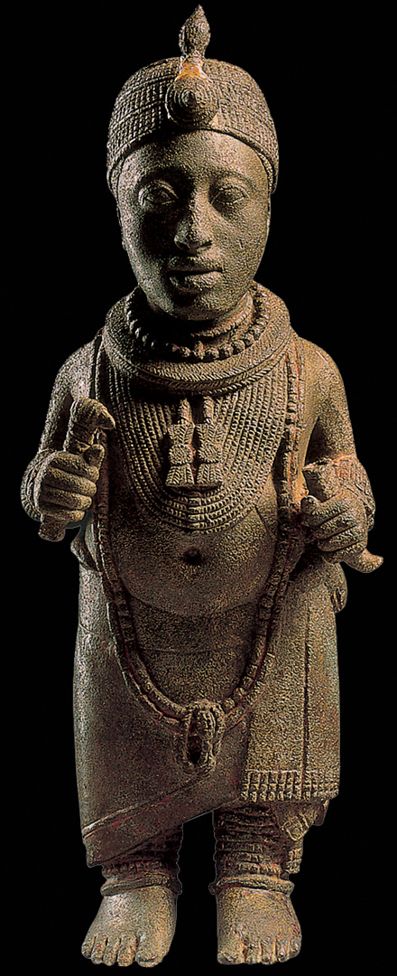
1.7.9 Nigerian Ife artist, Figure of Oni, early 14th–15th century. Brass with lead, height 18⅜". National Museum, Ife, Nigeria

Slide 3
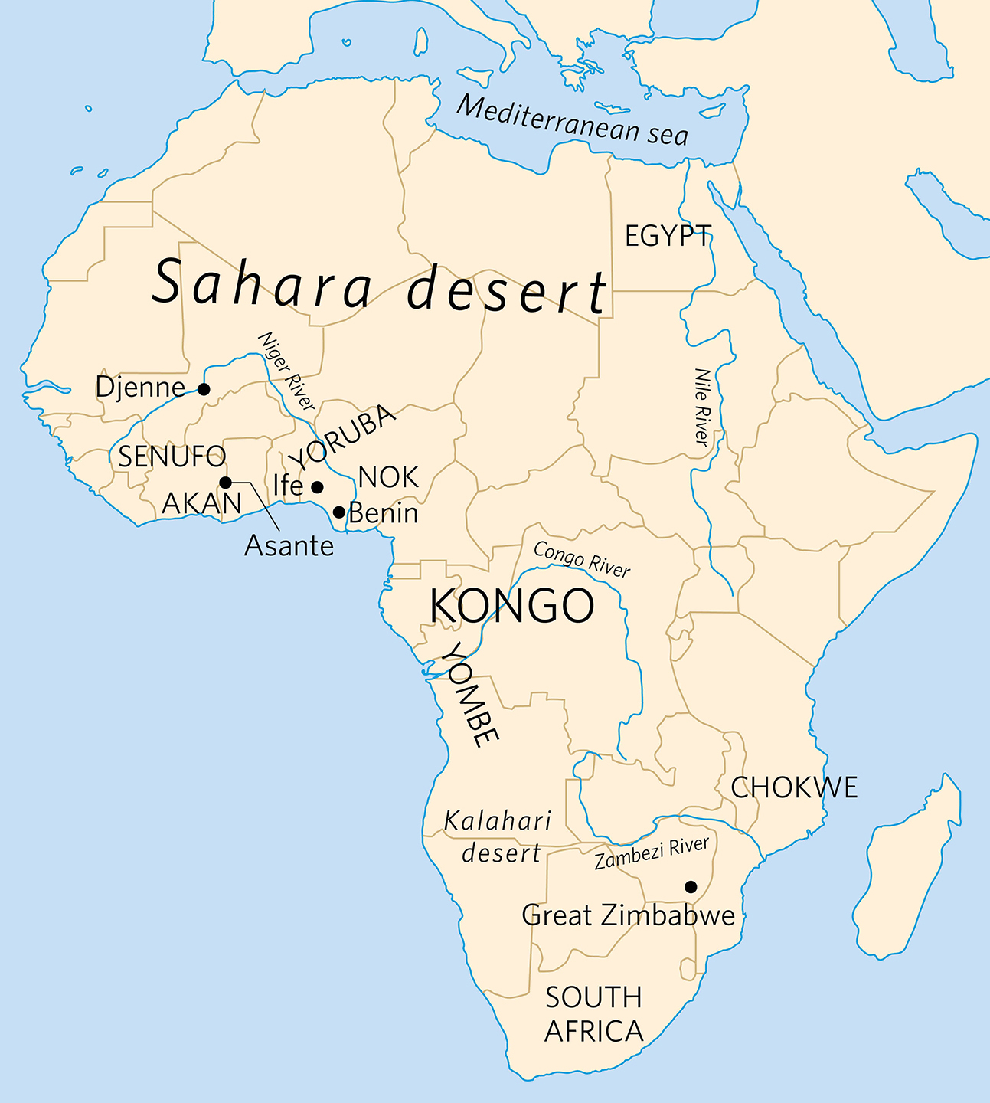
Map of Africa
3.5.1 Map of Africa

Slide 4
Art of Africa
Diverse continent: 54 countries, 1.2 billion inhabitants, 1,500 languages
Archaeological evidence from ~200,000 years ago indicates that the first modern humans lived in Africa before migrating to other parts of the world.
Oral history has been more important for African communities than written documents. Records of many events do not exist in many areas, especially south of the Sahara.
Thus, African art has been:
Important form of communication and cultural expression
Earliest examples date back 75,000 years ago (portable objects such as beads, shells)

Slide 5
Art of Africa and the Pacific Islands:
Integrates and responds to the environment
Incorporates mythological beliefs
Follows traditional methods of construction and decoration
Traditionally relies on natural materials: wood, reeds, shells, earth

Slide 6
Portraits and Power Figures
Art used to assert and reinforce the power of African rulers
They often stress their connection to spirit realm in order to encourage their people to believe that the gods or ancestor spirits gave them the right to rule.
Art can also act as a conduit or link between the spirit world and the human world.
Artworks are invested with power and that power is also associated with the owner.
Art communicates rules and customs
Objects can be symbolic, related to a position/role; or tell a story to communicate a message

Slide 7
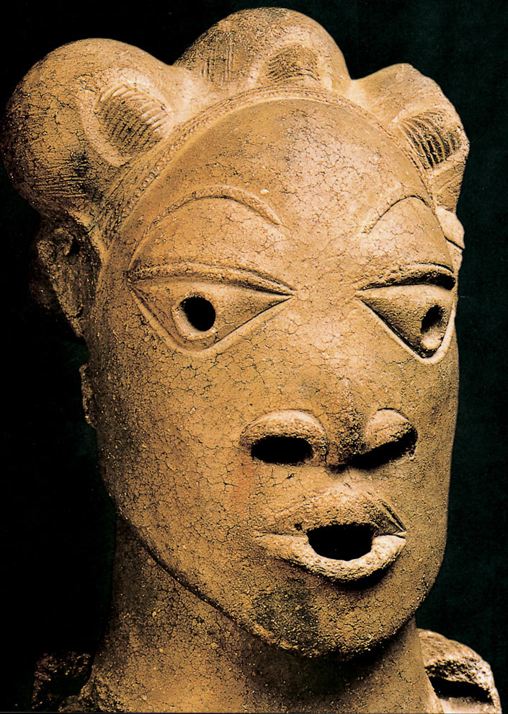
Head from Rafin Kura
The Nok of Nigeria created life-sized, hollow terra-cotta figures. Characteristics include:
Heads larger than the bodies. Head as the location of a person’s spirit.
Triangular-shaped eyes; holes for eyes, nose, mouth, ears
Distinctive hairstyle or headdress
Coiling technique.

Slide 8
3.5.2 Head from Rafin Kura, c. 500 BCE–200 CE. Terra-cotta, 14¼” high. National Museum, Lagos, Nigeria

Slide 9
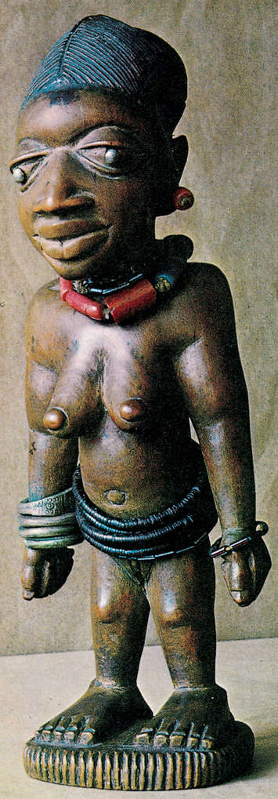
3.5.3 Twin figure, probably from Ado Odo in Yorubaland, pre-1877 (probably 19th century). Wood, 10” high. Linden Museum, Stuttgart, Germany
Made by the Yoruba of western Nigeria
Figure known as ere ibeji

Slide 10
1.7.9 Nigerian Ife artist, Figure of Oni, early 14th–15th century. Brass with lead, height 18⅜". National Museum, Ife, Nigeria

Slide 11
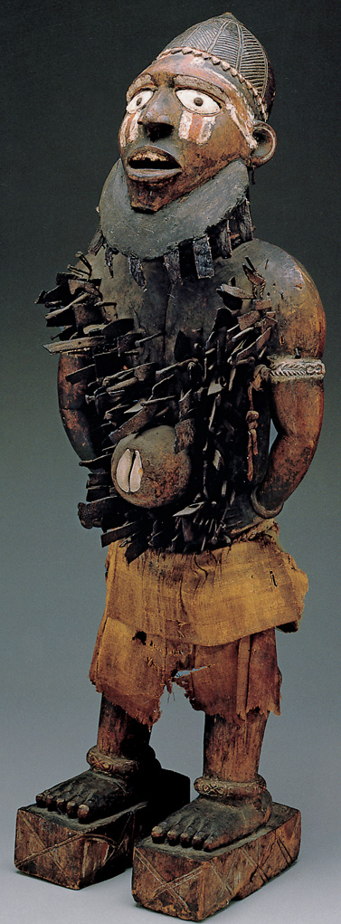
Standing male figure (nkisi nkondi)=Sacred Medicine Hunter Made by Yombe (Kongo area of West Africa)
3.5.4 Standing male figure (nkisi nkondi), late 19th century. Wood, iron, raffia, ceramic, kaolin pigment, red camwood powder (tukula), resin, dirt, leaves, animal skin, and cowrie shell, 43¾ × 15½ × 11”. Dallas Museum of Art, Texas

Slide 12
Personal Stories and Symbolism
In Africa, information has traditionally been shared orally or visually
Abstract designs and patterns
Can be read and understood like representational imagery
Symbols, colors, and materials all give specific information: a person’s age, status/position, and cultural connections

Slide 13
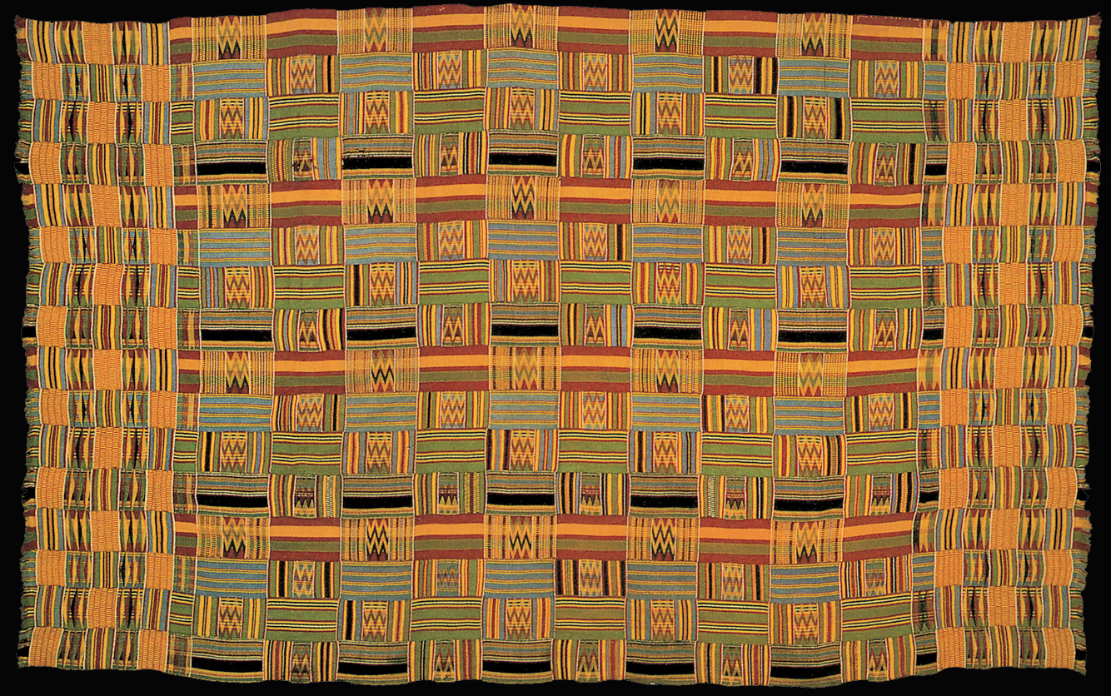
Textile wrapper (kente)
Kente is a woven fabric from the Kingdom of Asante, Ghana, West Africa
Traditionally worn only by royalty and state officials
Symbolic use of color: yellow (holy, precious), gold (royalty, wealth, spiritual purity), green (growth, good health), red (strong political and spiritual feelings)

Slide 14
3.5.5 Textile wrapper (kente), 20th century. Silk, 6’10½” long. National Museum of African Art, Smithsonian Institution, Washington, D.C.

Slide 15
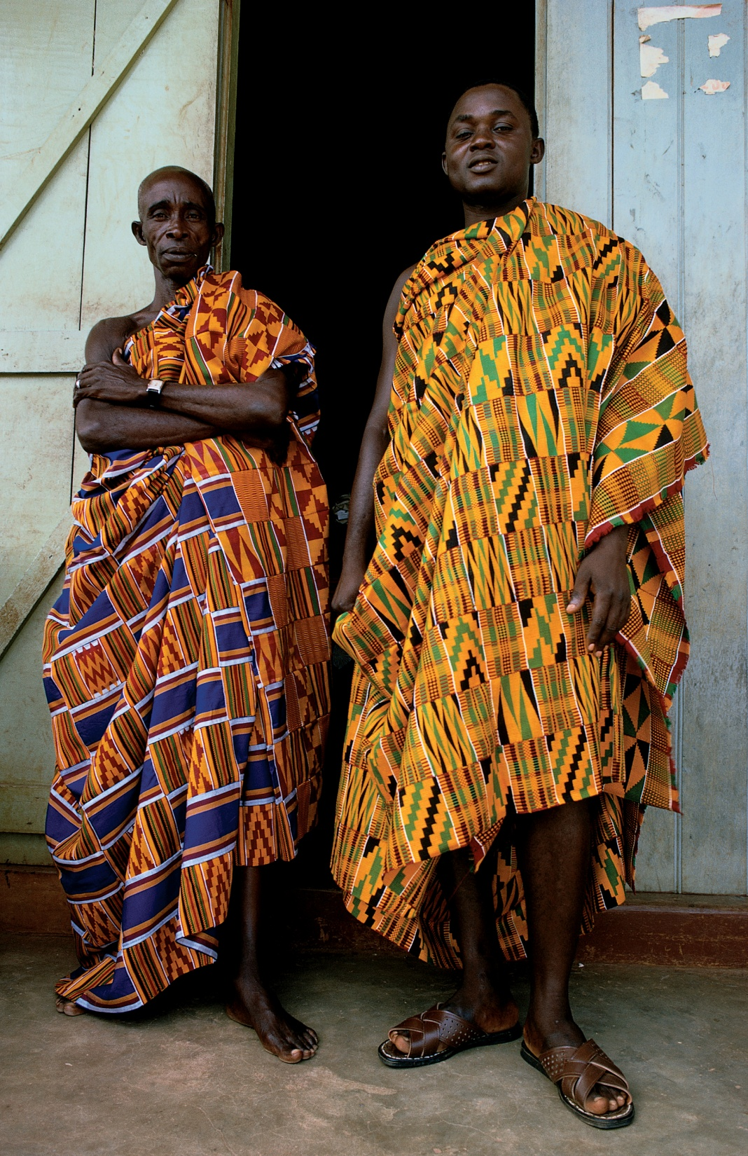
Two Asante noblemen wearing kente cloth robes, Kumasi, Ghana, January 1972.

Slide 16
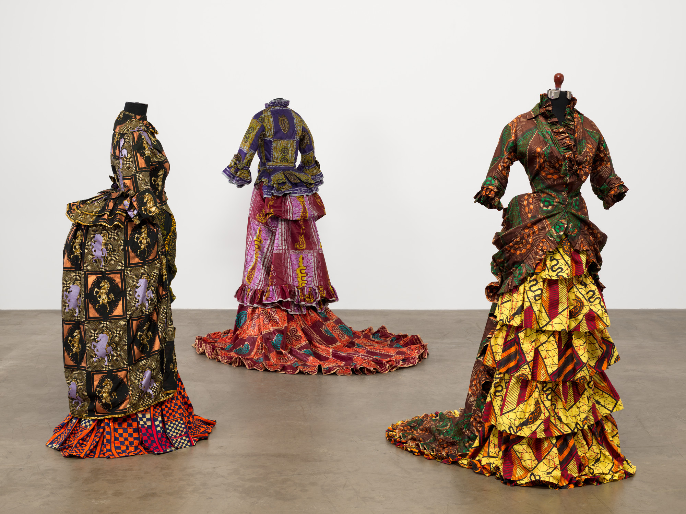
Yinka Shonibare, How Does a Girl Like You Get to Be a Girl Like You?, 1995.
Notes:
Distinctive fabrics associated with Africa also feature prominently in contemporary British-Nigerian artist Yinka Shonibare’s sculptural installations.

Slide 17
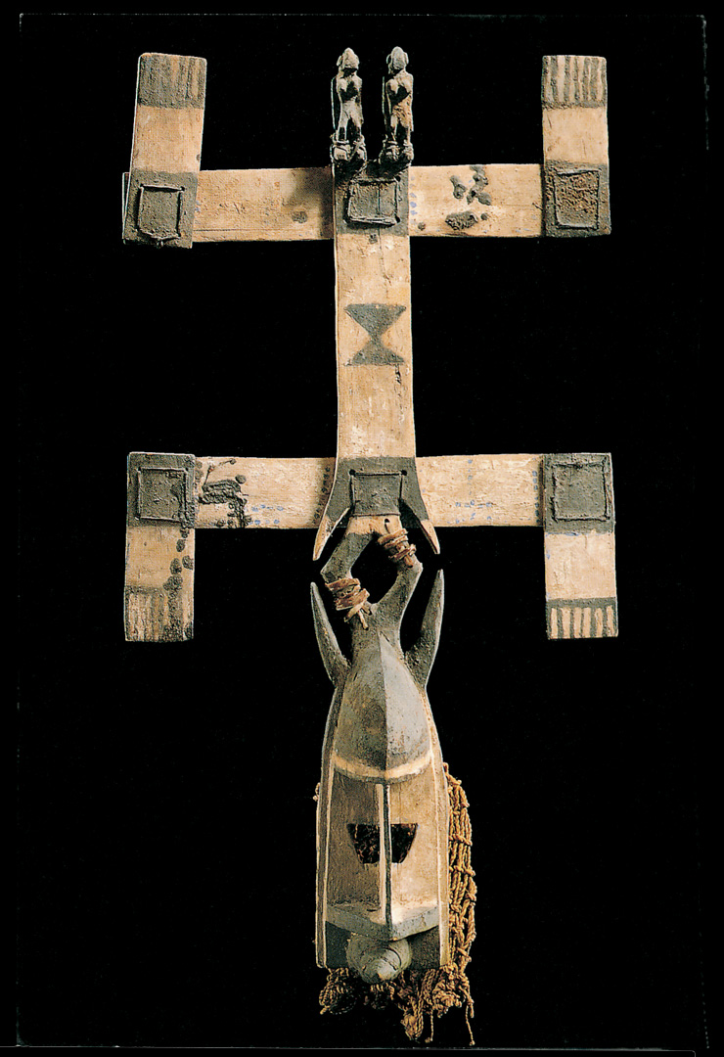
Kanaga Mask
Created by the Dogon of Mali in West Africa
Assists the dead in their journey into the spiritual realm
Used in funeral rituals, called dama
The two cross bars on the mask represent the lower earthly realm and the upper cosmic realm of the sky

Slide 18
3.5.6a Kanaga mask from Mali, Dogon culture, early 20th century. Polychrome wood, leather cords, and hide, height 45¼”. Musée Barbier-Mueller, Geneva, Switzerland

Slide 19
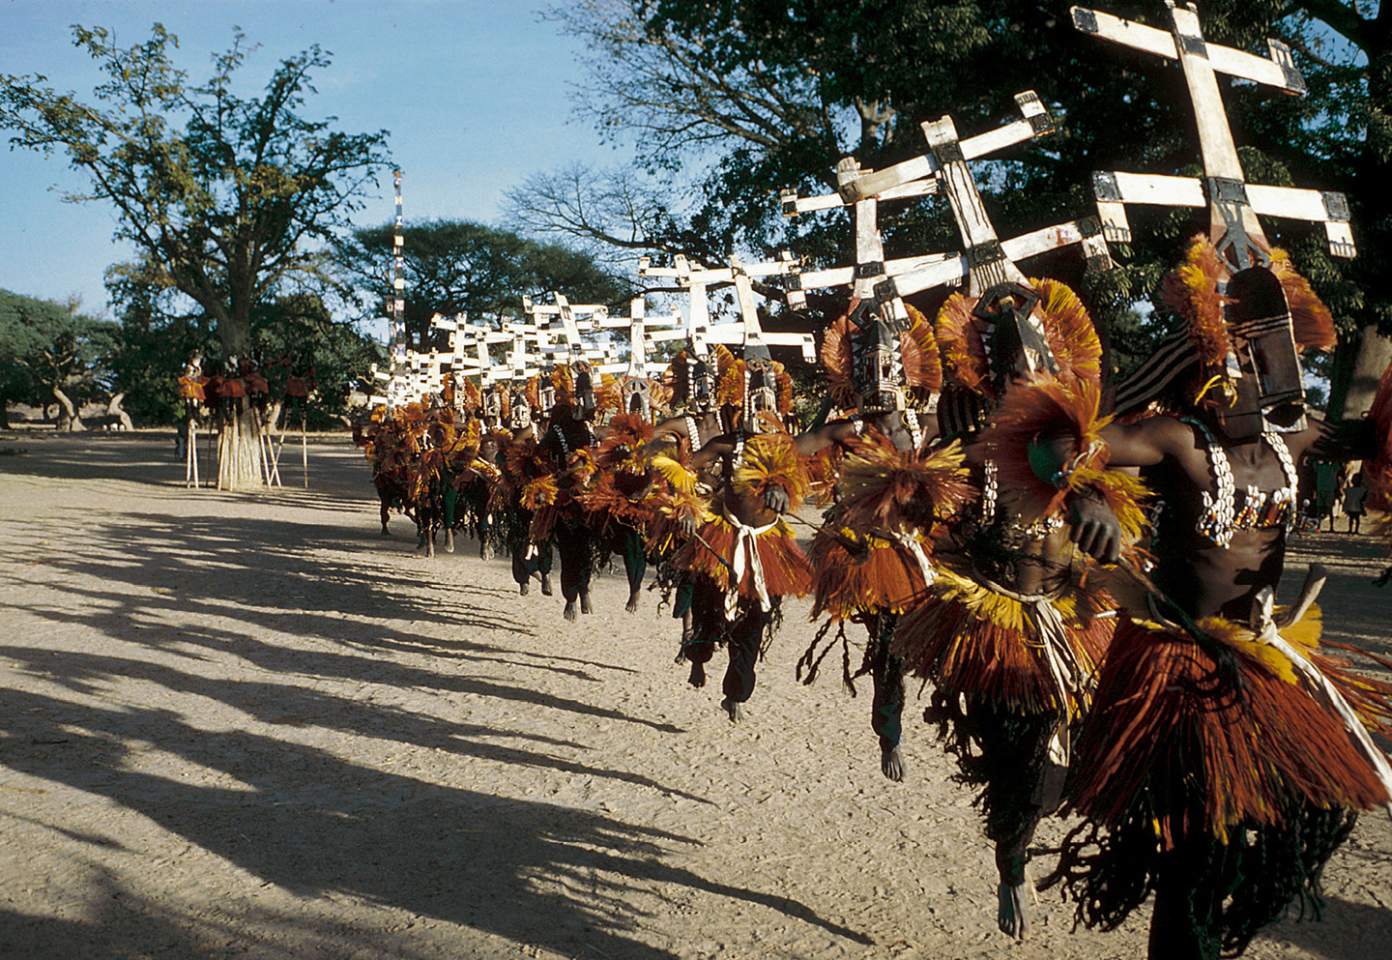
3.5.6b Dogon Kanaga mask ceremony, Bandiagara, Mali, West Africa

Slide 20
Benin Kingdom (13th to 16th centuries)
According to oral tradition, the first Benin king in the 13th c. was the grandson of an Ife king.
Benin reached its height of power and territorial extent in the 16th c.
The kingdom’s slow decline thereafter culminated in 1897 when the British burned the city and palace.

Slide 21
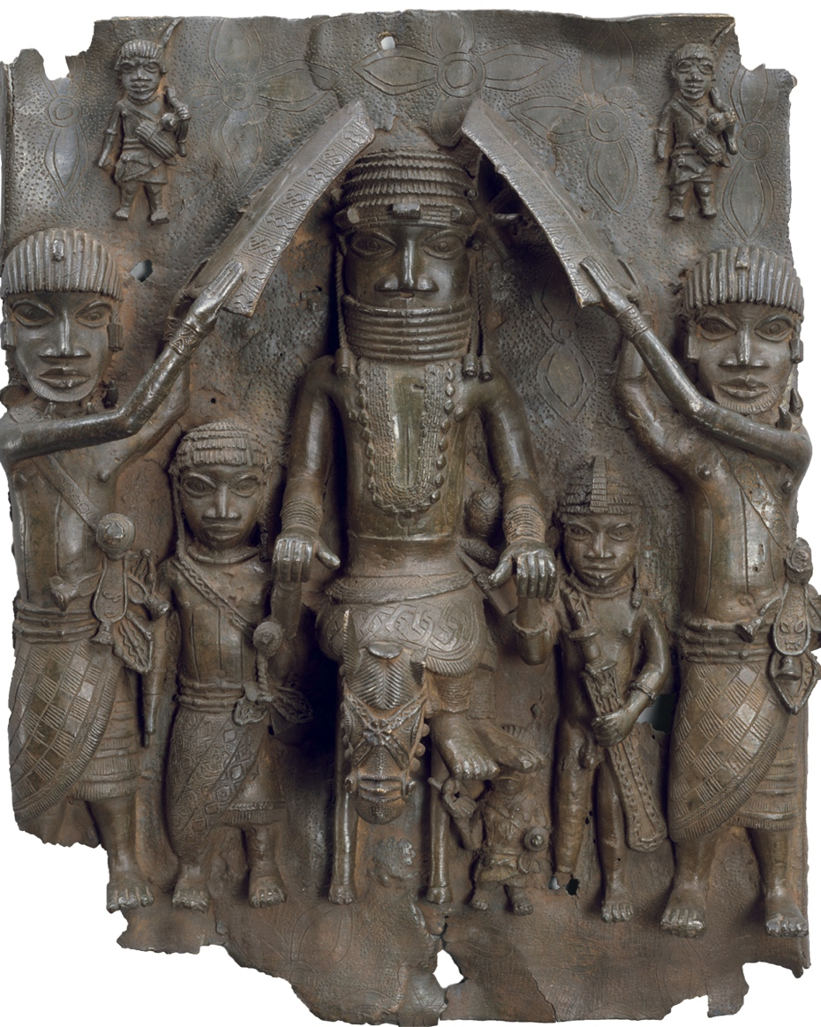
Royal Plaque, from Benin, Nigeria, 1550-1680. Bronze, 1’7 ½” x 1’ 4 ½” high. British Museum, London.

Slide 22
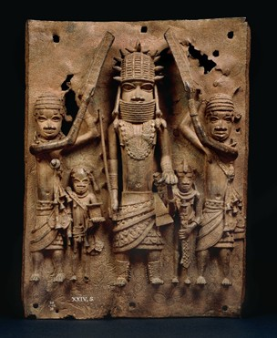
King with 4 attendants, Benin Plaques, 16th-17th c. Brass, 15” x 20.” The British Museum.

Slide 23
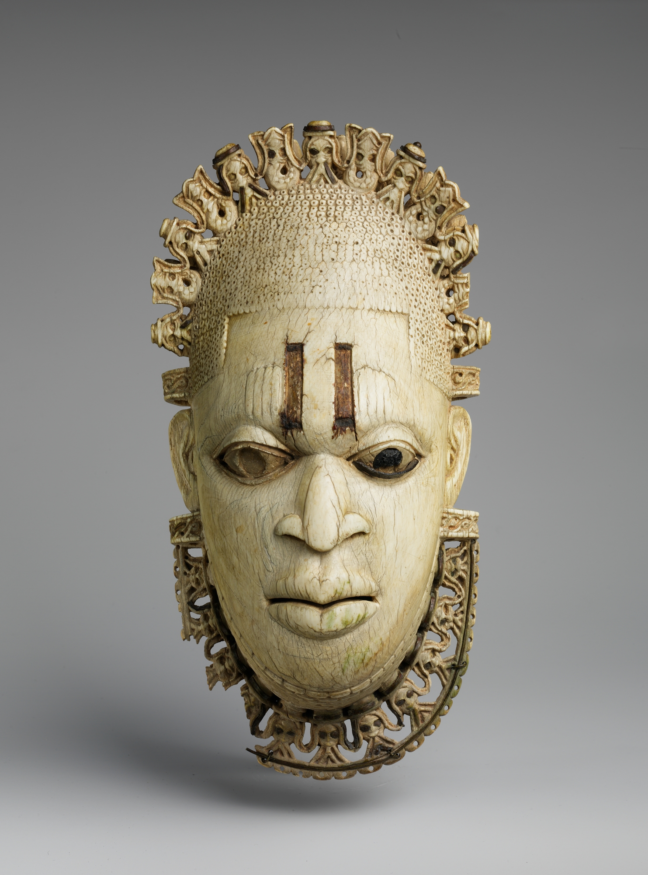
Queen Idia, mother of Oba Esigie of Benin, 16th century. Waist pendant made of ivory, 5 x 9 3/8.” Metropolitan Museum of Art, NYC.

Slide 24
African Architecture
Many buildings made of perishable materials (wood, mud-brick)
Symbolism and ornamentation of the structures communicate:
Spiritual concerns
Ties to ancestors
Connections with nature

Slide 25
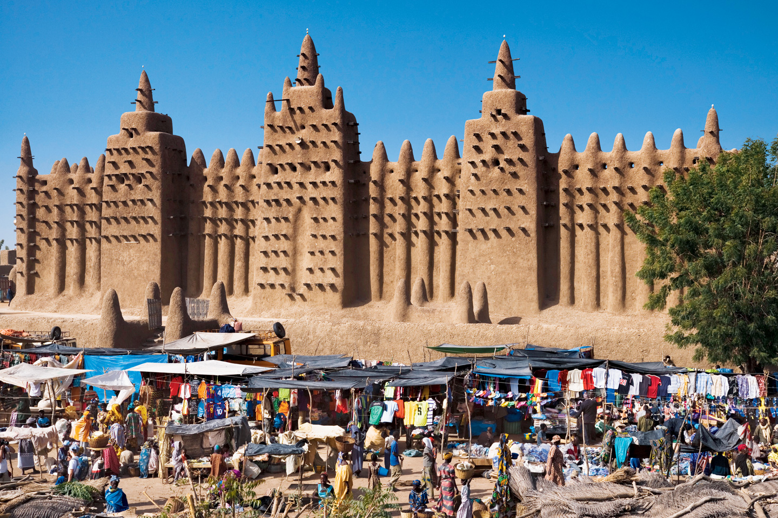
Great Mosque, Djenné, Mali
3.5.7 Monday market, Great Mosque, Djenné, Mali, Africa. The earliest mosque on this site was built in the 13th c. after King Koi Konboro converted to Islam. In 1834, Sheikh Amadou Labbo ordered that mosque to be demolished. The current building was completed in 1907.

Slide 26
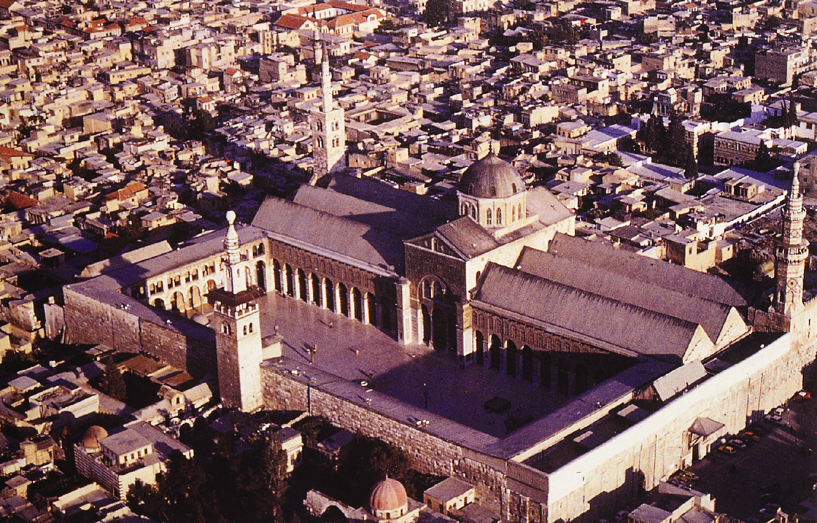
Aerial view of the Great Mosque, Damascus, Syria, 706–715.

Slide 27
Art of the Pacific Islands
Geographic area covers islands in the Pacific Ocean: Polynesia, Melanesia, Micronesia, Australia
Artworks include: portable objects (jewelry, furniture, weapons), body ornamentation, wooden sculpture, paintings on rock, and ceremonial architecture
Mana=magical power is a strong influence

Slide 28
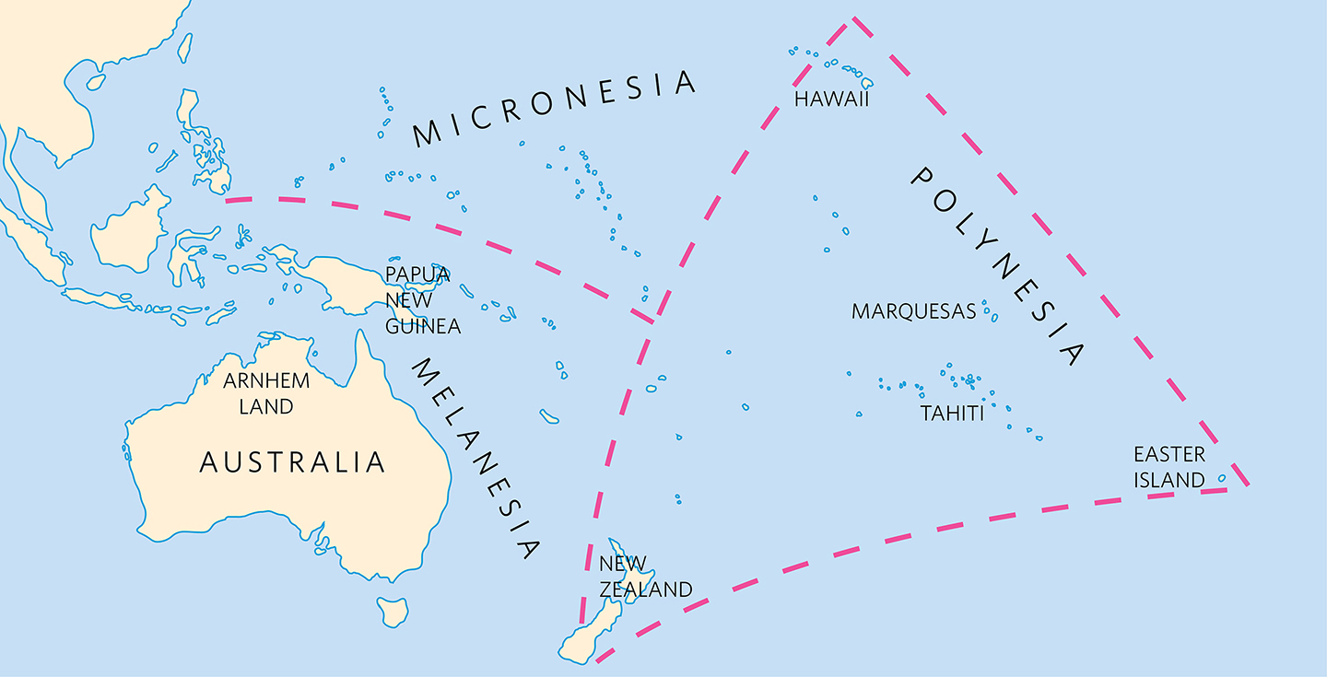
Map of the Pacific Islands
3.5.12 Map of the Pacific Islands

Slide 29
New Zealand
Inhabited by the Maori, who have an elaborate tradition of tattooing
Earliest preserved tattooed bodies date to c. 3300 bce
Feature abstract designs with dots and line patterns

Slide 30
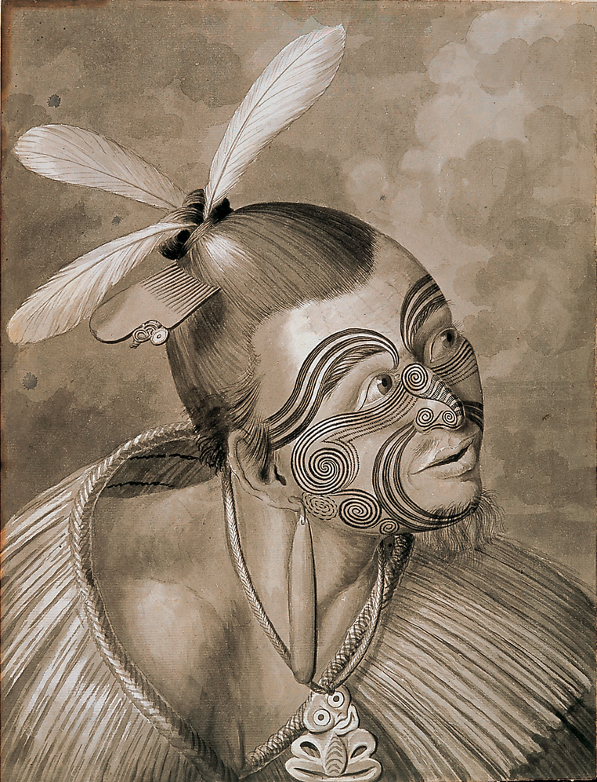
Sydney Parkinson, Drawing of traditional Maori tattoo
Tattoos are called ta moko or moko
Mark important events in the wearer’s life (puberty, marriage)
Indicate social status
No two designs are alike; were at times used as a form of legal signature

Slide 31
3.5.12 Sydney Parkinson, Drawing of traditional Maori tattoo, from A Journal of a Voyage to the South Seas (1784), plate 16

Slide 32
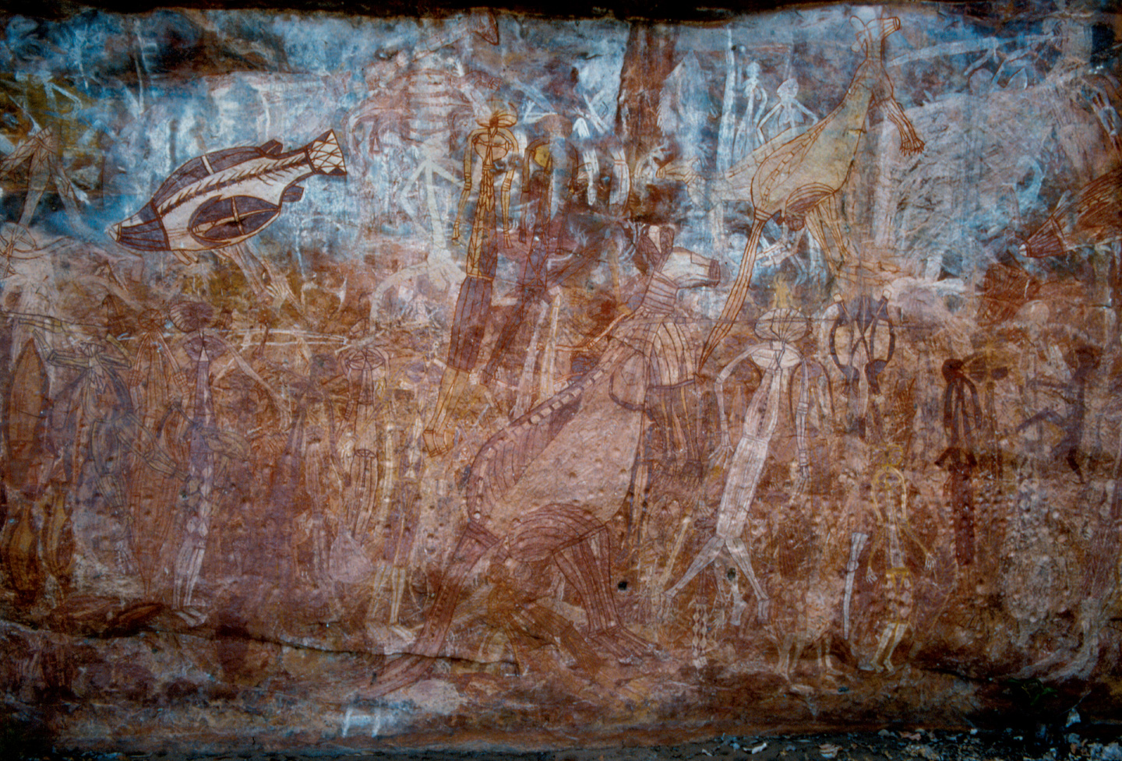
3.5.14 X-ray kangaroo rock painting, c. 1900. Ocher and kaolin paint, 6’9½” high. Kakadu National Park, Northern Territory, Australia

Slide 33
Paul Tacon: Australian Rock Art
Subject matter derived from Aboriginal experience and nature
Mythological, linked to storytelling
“Mimi” is a spirit who taught humans to hunt and paint
Figures painted with “x-ray” detail: spine and internal organs visible
Notes:
Some form of Aboriginal art has been practiced for at least 40,000 years
It is estimated there are well over 100,000 surviving rock art sites—places with paintings, drawings, stencils, carvings, and figures made out of beeswax
Today, Aboriginal artists paint on such surfaces as sheets of bark, paper, canvas, bodies, houses, cars and use cameras, make films, and produce multimedia works
A concern for the land, people, and other creatures has always been important for all Aboriginal groups
The slender figure, a “Mimi,” is one of the spirits who taught humans to hunt and paint during one of the early eras of the “Dreaming,” or the creation period
It seems most paintings were not used as a magical aid to hunting. Rather, both X-ray and solid infill animals were more often painted after they were caught and as part of storytelling

Slide 34
Hawaii
First inhabited by Polynesians from Marquesas Islands c. 600 ce
Later, Tahitian settlers introduced a social hierarchy and new gods
King Kamehameha unified warring factions during the 18th century
Became the 50th US state in 1959; has also kept Tahitian and Polynesian roots

Slide 35
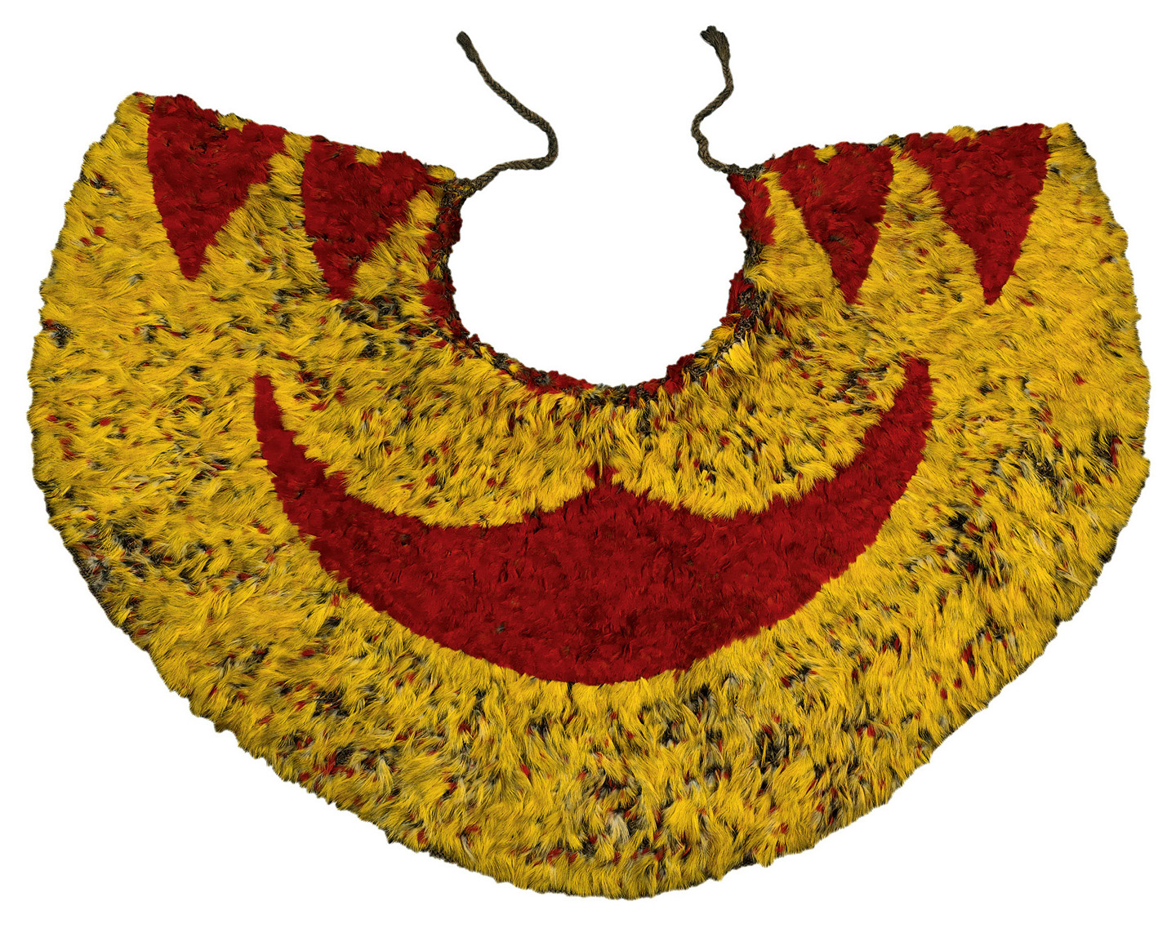
Ahu’ula: Cloak of red and yellow feathers
3.5.15a Cloak of red and yellow feathers, Hawaii, 18th century (?). Width 26½ × 12¼”. British Museum, London, England

Slide 36
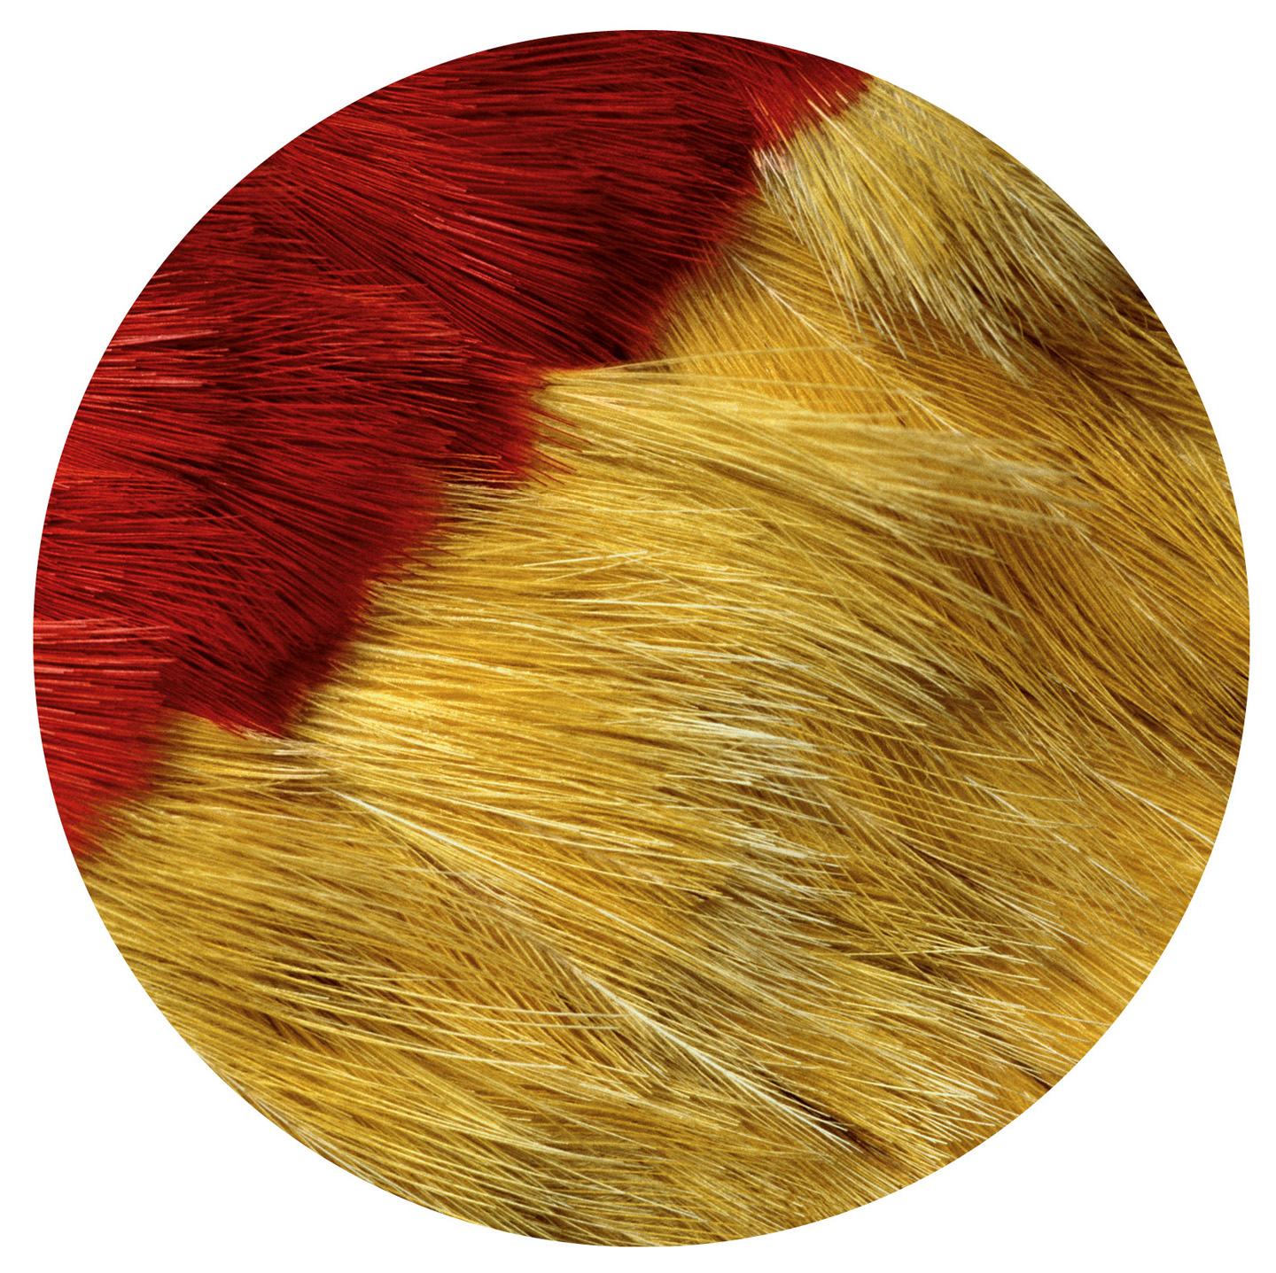
3.5.15b Detail of Hawaiian feather cloak

Slide 37
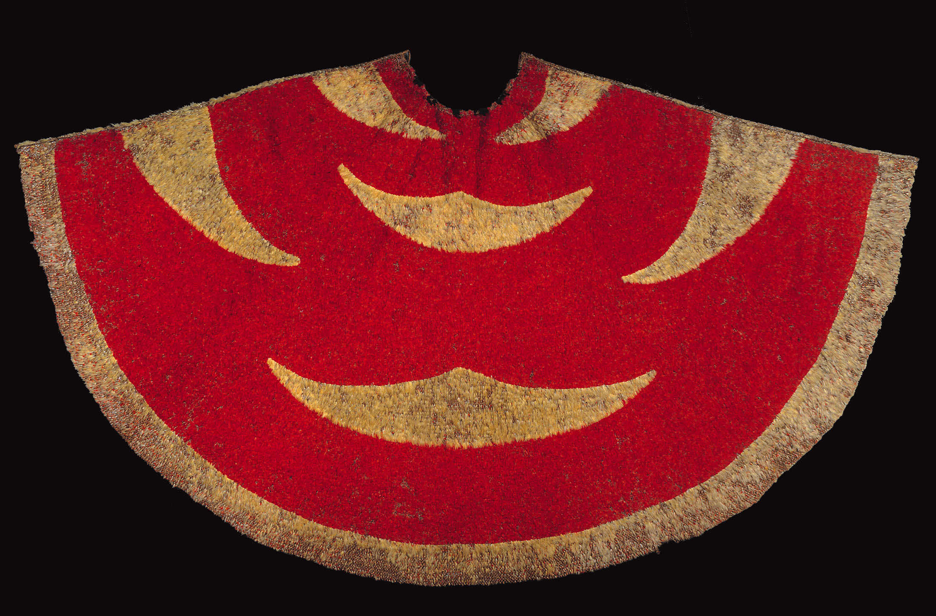
Feather cloak, from Hawaii, Polynesia, ca. 1824–1843. Feathers and ﬁber netting, 4’8 1/3” X8’. Bishop Pauahi Museum, Honolulu.

Slide 38
Easter Island
Small, isolated island in Polynesia
15 miles long by 7½ miles wide
1,300 miles off the coast of Chile
Famous for abstract monolithic stone sculptures called moai
Meaning “seamount,” “image,” “statue,” or “bearers of the gift”

Slide 39
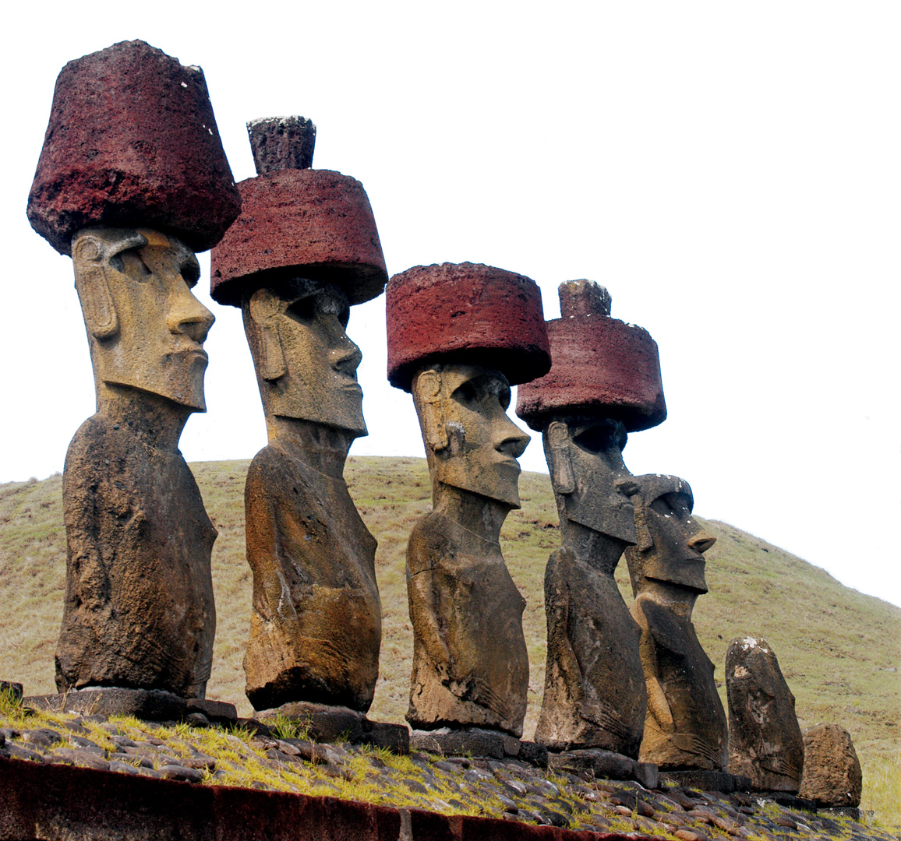
Moai ancestor figures
887 moai documented to date; placed especially along the coast
Carved from volcanic rock
Represent deified ancestors who were chiefs
General characteristics and unique individual features

Slide 40
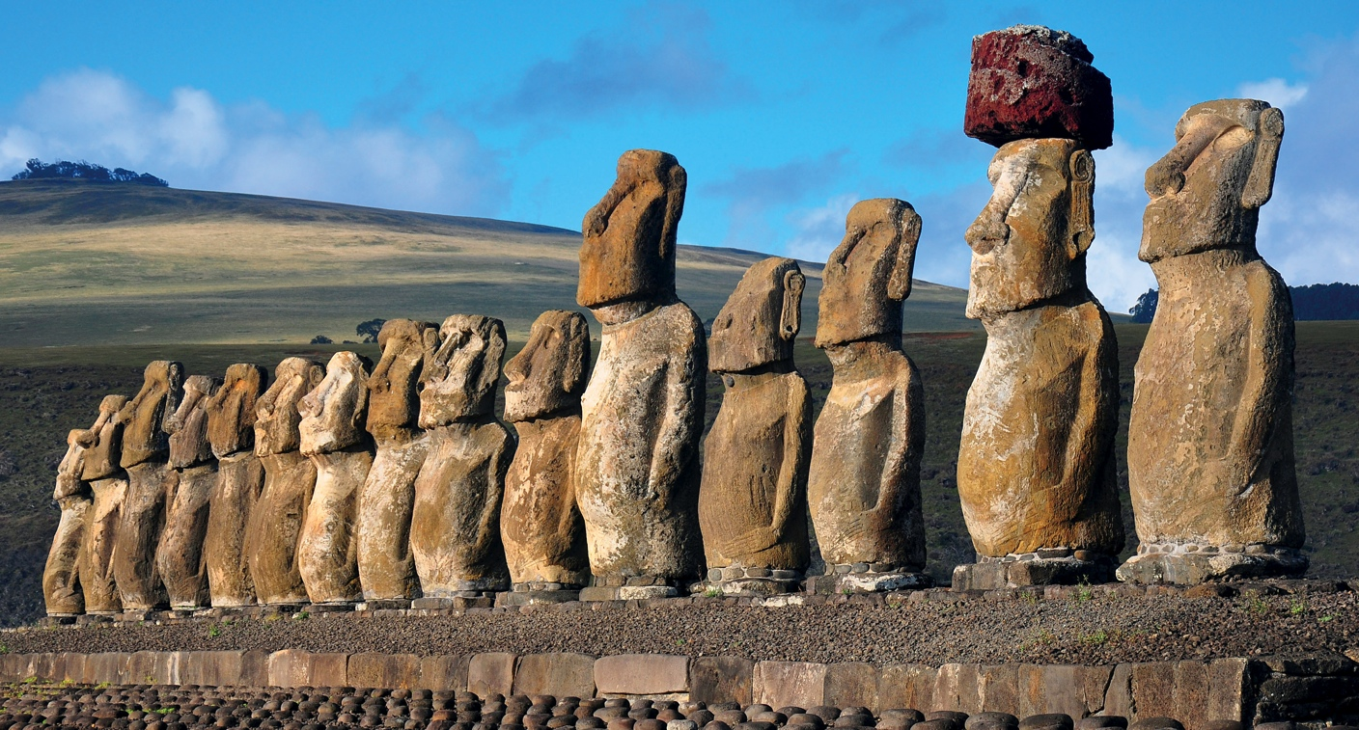
Figure 36-13 Row of moai on a stone platform, Rapa Nui (Easter Island), Polynesia, 10th to 12th centuries. Volcanic tuff and red scoria.

Slide 41
3.5.16 Moai ancestor figures, Ahu Nau Nau, Easter Island (Chile), before the 15th century

